Slide 1
2.3 General Conditional Expectations
報告人：李振綱

Slide 2


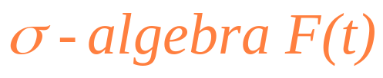

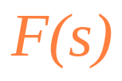







Review
Def 2.1.1 (P.51)
Let be a nonempty set. Let T be a fixed positive number, and assume that for each
there is a . Assume further that if , then every set in is also in .
Then we call ,
, a filtration.
Def 2.1.5 (P.53)
Let X be a r.v. defined on a nonempty sample space . Let be a
If every set in is also in , we say that X is
.

Slide 3





Review
Def 2.1.6 (P.53)
Let be a nonempty sample space equipped with a filtration , .
Let be a collection of r.v.’s is an adapted stochastic process if, for each t, the r.v. is
.

Slide 4

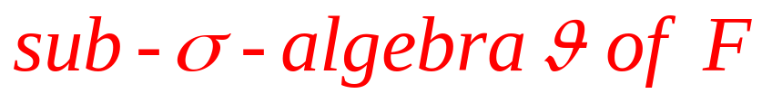



Introduction
and a
If X is the information in is sufficient to determine the value of X.
If X is independent of , then the information in provides no help in determining the value of X.
In the intermediate case, we can use the information in to estimate but not precisely evaluate X.

Slide 5

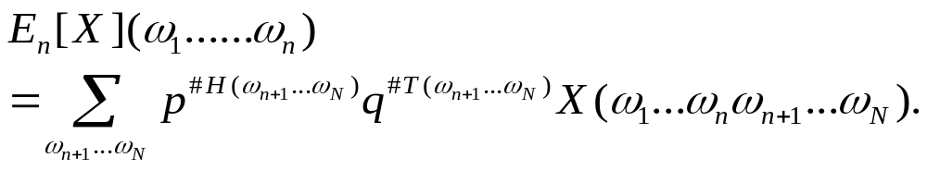
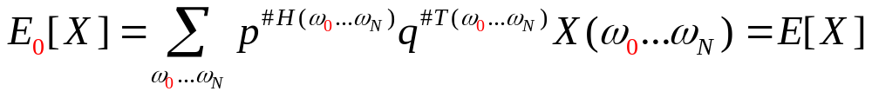
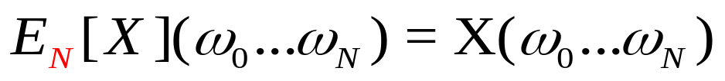
Toss coins
Let be the set of all possible outcomes of
N coin tosses,
p : probability for head
q=(1-p) : probability for tail
Special cases n=0 and n=N,

Slide 6


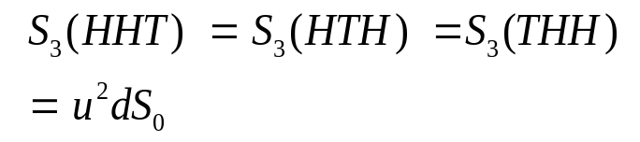




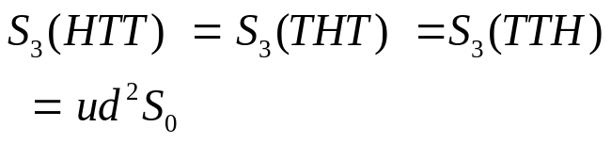



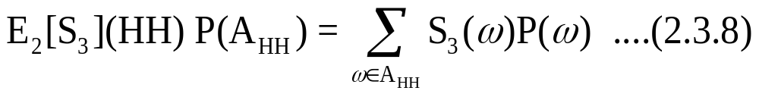
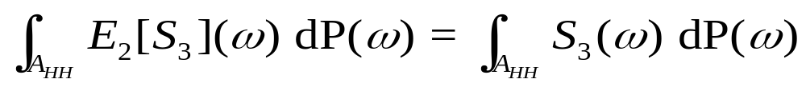
Example (discrete → continous)
Consider the three-period model.(P.66~68)
(間斷)
(Lebesgue integral)
(連續)

Slide 7





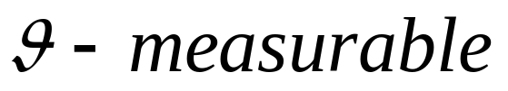
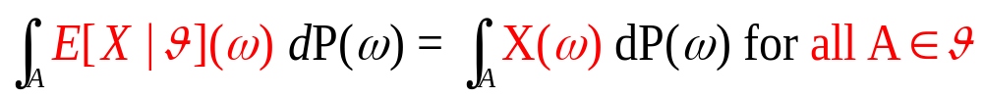
General Conditional Expectations
Def 2.3.1.
let be a probability space, let be a
, and let X be a r.v. that is either nonnegative or integrable. The conditional expectation of X given , denoted , is any r.v. that satisfies
(i) (Measurability)
is
(ii) (Partial averaging)

Slide 8



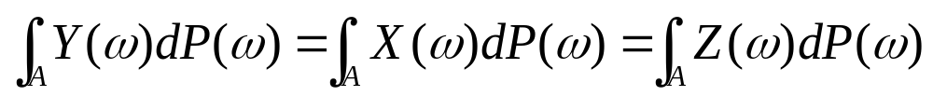
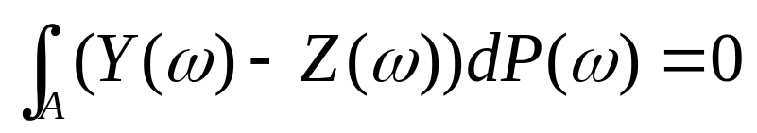


unique ?
(See P.69)
Suppose Y and Z both satisfy condition(i) ans (ii) of Def 2.3.1. Suppose both Y and Z are
, their difference Y-Z is as well, and thus the set A={Y-Z>0} is in . So we have
and thus
The integrand is strictly positive on the set A, so the only way this equation can hold is for A to have probability zero(i.e. Y Z almost surely). We can reverse the roles of Y and Z in this argument and conclude that Y Z almost surely . Hence Y=Z almost surely.

Slide 9


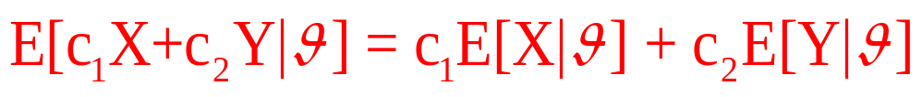

General Conditional Expectations Properties
Theorem 2.3.2
let be a probability space and let be a .
(i) (Linearity of conditional expectation) If X and Y are
integrable r.v.’s and and are constants, then
(ii) (Taking out what is known) If X and Y are integrable
r.v.’s, Y and XY are integrable, and X is

Slide 10


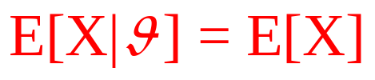

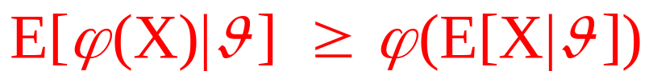
General Conditional Expectations Properties(conti.)
(iii) (Iterated condition)If H is a and X is an integrable r.v., then
(iv) (Independence)If X is integrable and independent of
, then
(v) (Conditional Jensen’s inequality)If is a convex function of a dummy variable x and X is integrable, then
p.f(Volume1 P.30)

Slide 11
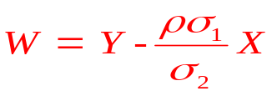
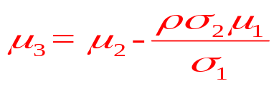


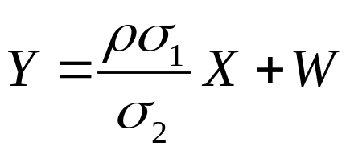
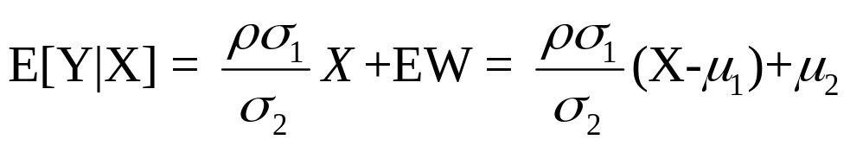


Example 2.3.3. (P.73)
X and Y be a pair of jointly normal random variables. Define so that X and W are independent, we know W is normal with mean and variance . Let us take the conditioning to be .We estimate Y, based on X.
so,
(The error is random, with expected value zero, and is independent of the estimate E[Y|X].)
In general, the error and the conditioning r.v. are uncorrelated, but not necessarily independent.

Slide 12
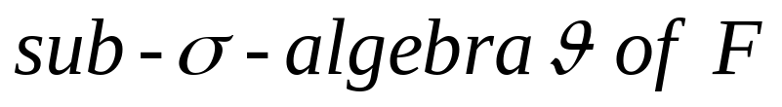

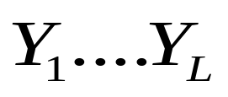
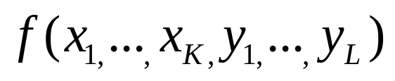
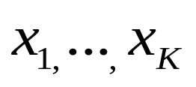
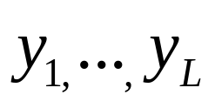
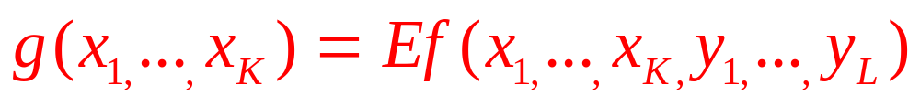
Lemma 2.3.4.(Independence)
let be a probability space, and let be a . Suppose the r.v.’s
are and the r.v.’s
are independent of . Let be a function of the dummy variables and define
Then

Slide 13

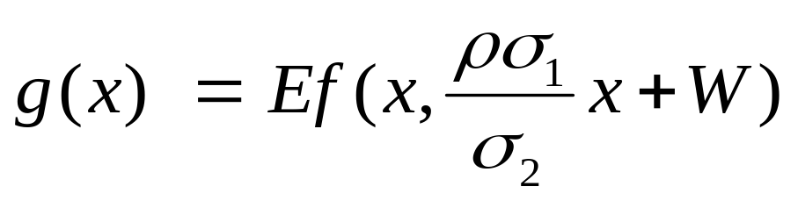
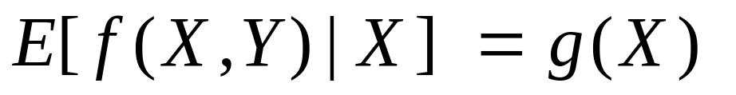
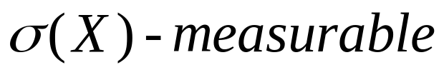
Example 2.3.3.(conti.) (P.73)
Estimate some function of the r.v.’s X and Y based on knowledge of X.
By Lemma 2.3.4
Our final answer is random but .

Slide 14



Martingale
Def 2.3.5.
let be a probability space, let T be a fixed positive number, and let , , be a filtration of . Consider an adapted stochastic process M(t), .
(i) If
we say this process is a martingale. It has no tendency to rise or fall.
(ii) If
we say this process is a submartingale. It has no tendency to fall; it may have a tendency to rise.
(iii) If
we say this process is a supermartingale. It has no tendency to rise; it may have a tendency to fall.

Slide 15


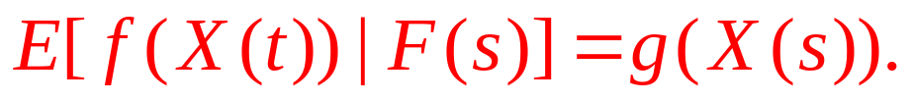
Markov process
Def 2.3.6.
Continued Def 2.3.5. Consider an adapted stochastic process , .
Assume that for all and for every nonnegative, Borel-measurable function f, there is another Borel-measurable function g such that
Then we say that the X is a Markov process.

Slide 16
Thank you for your listening!!

